Slide 1


comprehensive management system for university training
Yazan Alamleh 1190304
Ashraf Mtor 1183389
Mohammad Rabba 1192393

Slide 2
Introduction
Problems
Related Work
System Objectives
CONTENT
Software Diagrams
Future Work
Conclusion

Slide 3
Main work:
Understanding the university training process.
Identifying problems and areas of improvement.
Defining objectives.
system requirements.
Existing systems study.

Slide 4

Introduction
Practical training is an integral part of the stage of the educational process for universities, where the student must acquire at least 80 hours to participate in the educational process, which provides a real environment to work for companies and understand the problems and challenges that can be encountered at work.
It’s allows students to apply theoretical knowledge gained in the classroom to real-world scenarios. It also helps students develop essential skills such as problem-solving, teamwork, and communication, which are crucial for their future careers.

Slide 5

Main Problems
Manual and time-consuming
processes
Limited opportunities
for students
Unstructured
data management
Tracking and monitoring
Outdated Training
Program Information
Lack of communication
and cooperation

Slide 6






Related Work
Jops.ps
EDX
LinkedIn
GlassDoor
Moodle
Scoology

Slide 7
System Objectives
Chat
Simplify Assignment
Management
6
Communication
5
7
Flexibility
Simplify Assignment Management
4
8
Validity
3
9
Efficiency
Good user
experience
2
10
Evaluation
1
Assessment

Slide 8
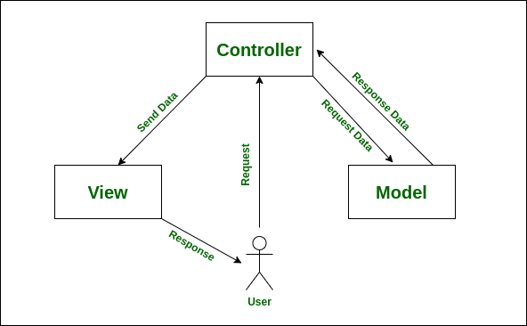
Spring MVC

Slide 9
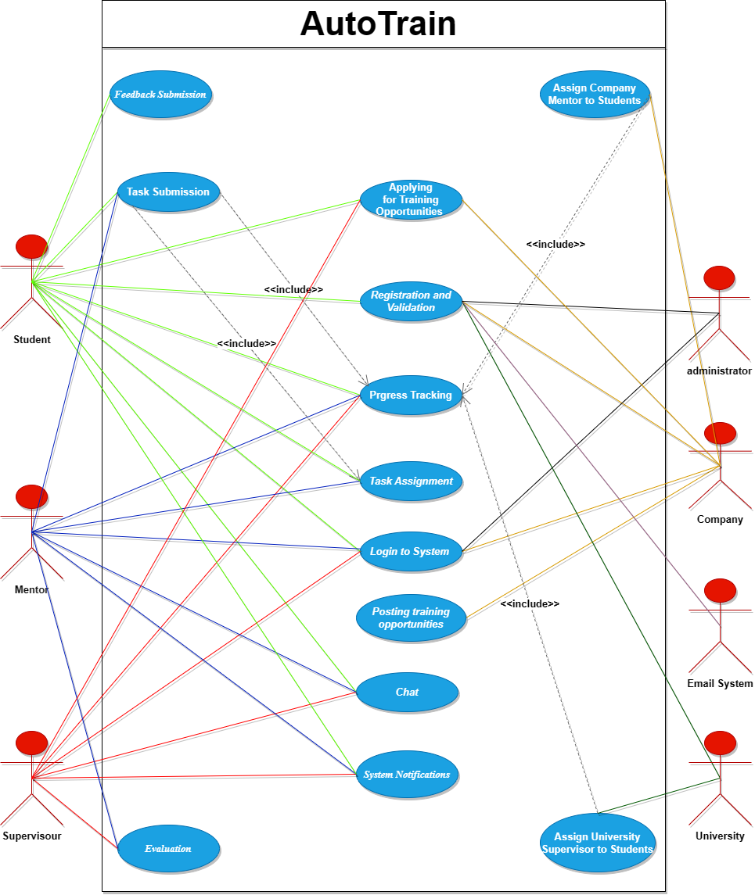
Use Case Diagram

Slide 10
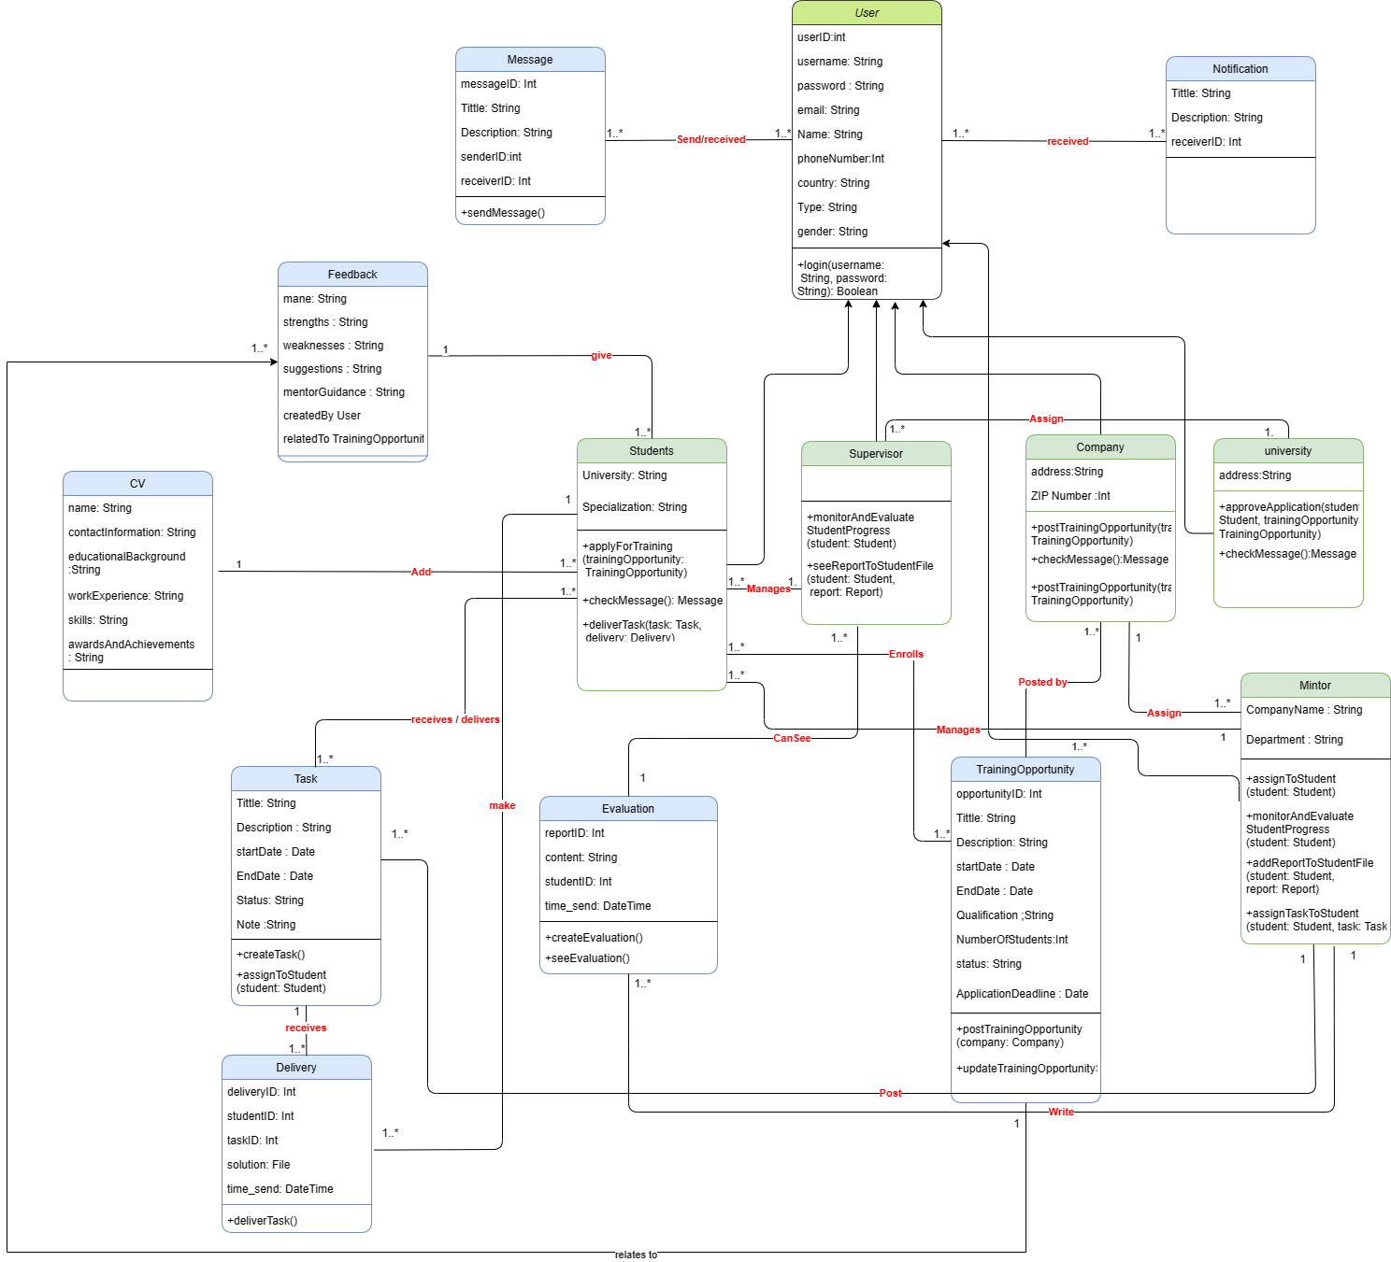
Class Diagram

Slide 11
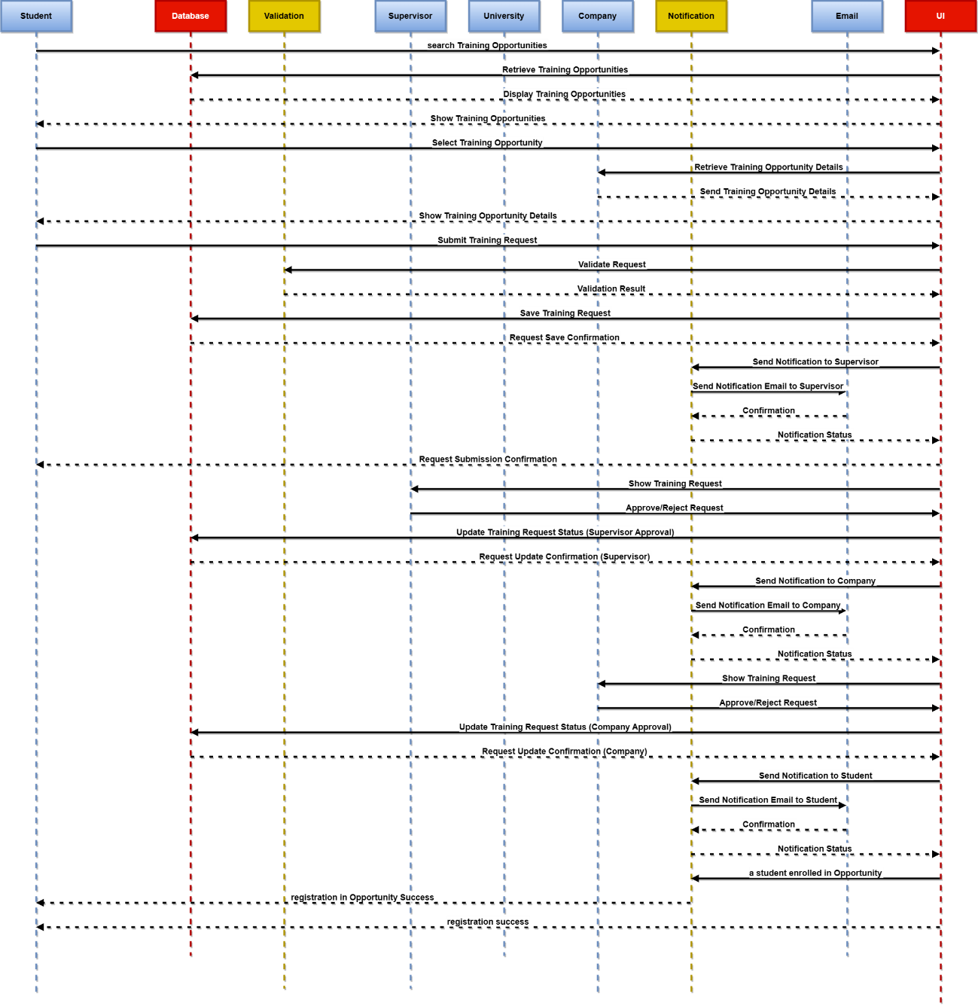
Sequenced Diagram
Application Training Opportunity

Slide 12
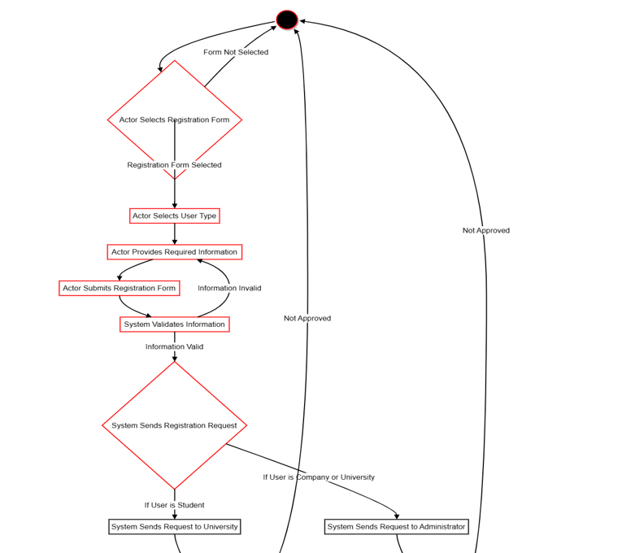
Activity Diagram

Slide 13
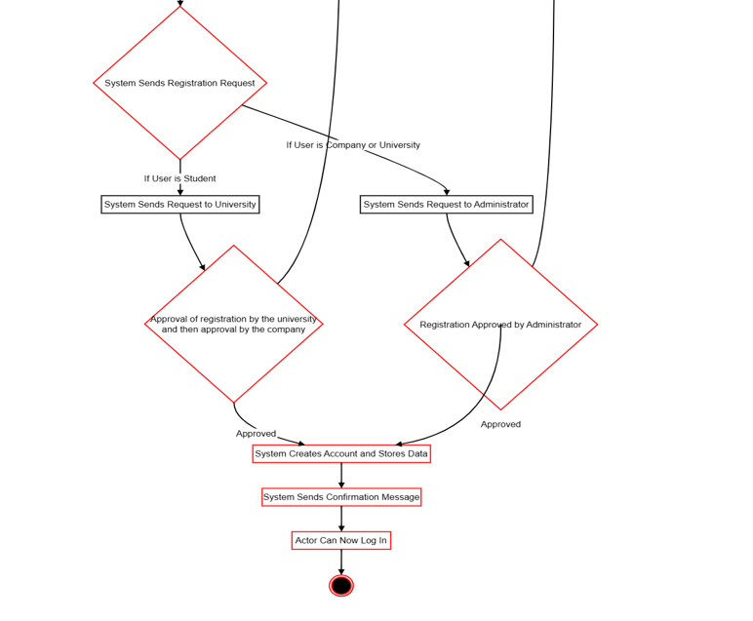
Activity Diagram

Slide 14
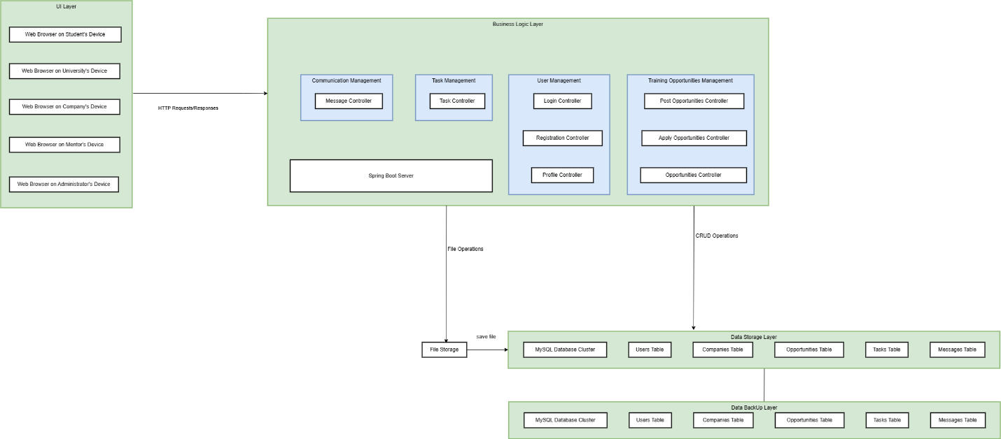
Deployment Diagram

Slide 15
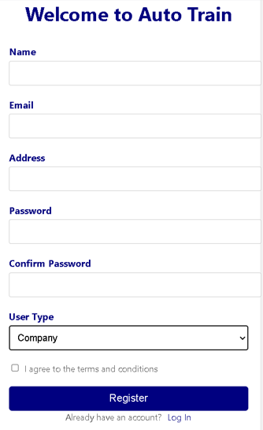
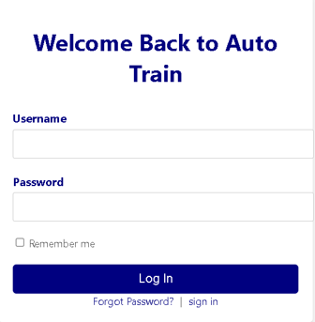
User Interface
UI 1
UI 2

Slide 16
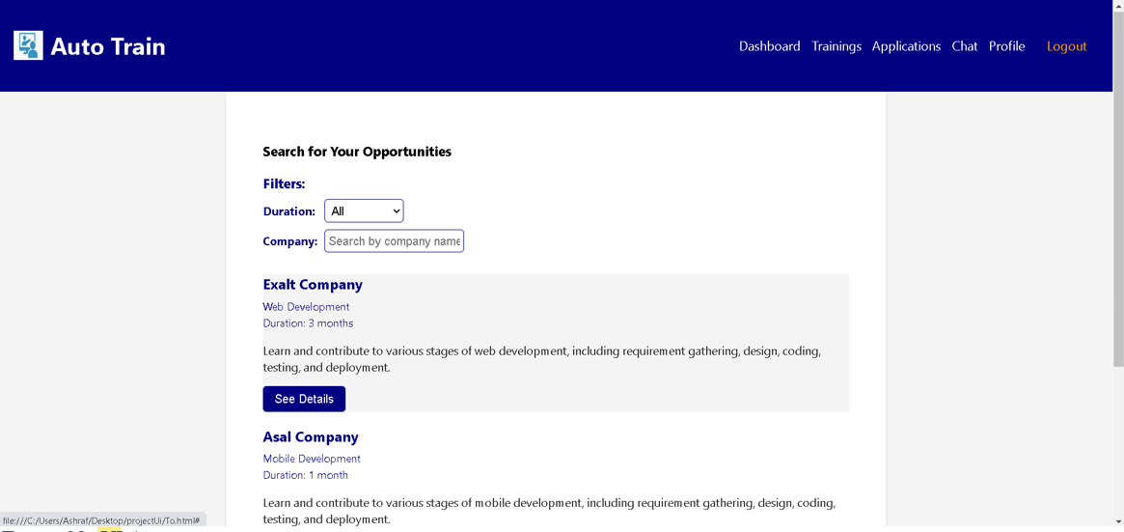
User Interface
UI 3

Slide 17
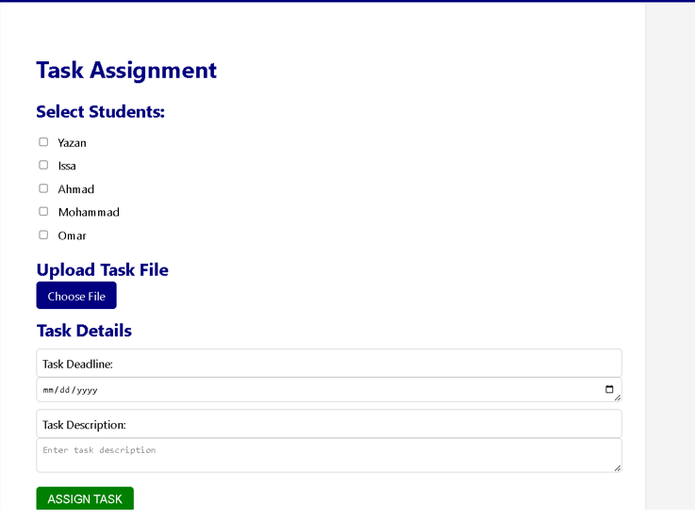
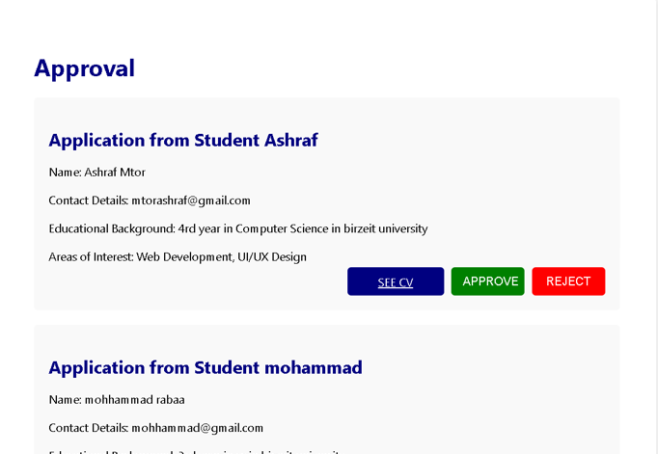
User Interface
UI 4
UI 5

Slide 18
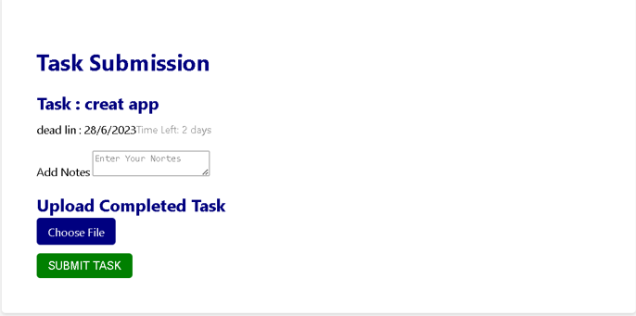
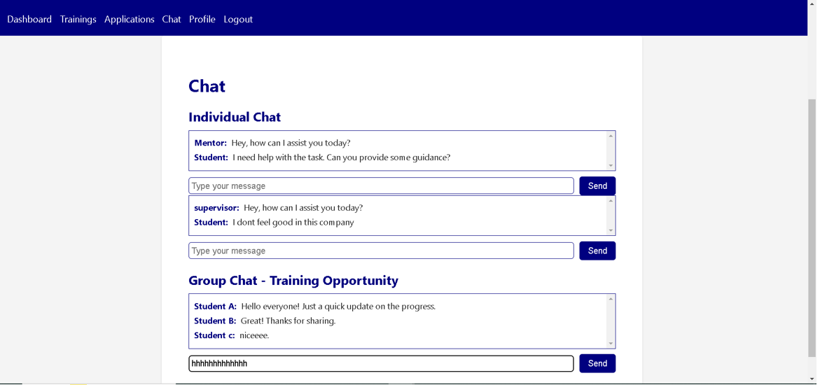
User Interface
UI 6
UI 7

Slide 19
Future Work
Mobile Applications
Jobs
Educational Courses
Recommended System

Slide 20

Conclusion
In conclusion, it is hoped that this presentation will provide
valuable information about the features of our web application.
Auto Train offers a much-needed solution to
Students and Universities who are looking for
high-quality educational services in the field
of practical training. In particular, our app
provides a comprehensive, easy-to-use
solution to enhance program effectiveness
in Universities.
Embracing this transformative platform will elevate
educational services and prepare students for future
success. It is the perfect solution to all
practical training problems faced by all universities.

Slide 21

THANKS
DO YOU HAVE ANY QUESTIONS ?

